Slide 1

SQL
Structure Query Language.
It is used for storing and managing data in RDBMS. It enables a user to create, read, update and delete relational databases and tables.
SQL allows users to query the database in a numbers of ways, using English-like statements.

Slide 2
SQL Datatypes
SQL Datatypes
Binary
Approximate Numeric
Exact Numeric
Date
String

Slide 3
Binary Datatypes
DATA TYPE | DESCRIPTION
BINARY | Maximum length of 8000 bytes Fixed-length binary data
VARBINARY | Maximum length of 8000 bytes Variable-length binary data
IMAGE | Maximum length of 2,147,483,647 bytes Variable-length binary data

Slide 4
Approximate Numeric Datatypes
DATA TYPE | FROM | TO
FLOAT | -1.79E + 308 | 1.79E + 308
REAL | -3.40e + 38 | -3.40e + 38

Slide 5
Exact Numeric Datatypes
DATA TYPE | FROM | TO | STORAGE
bit | 0 | 1
tinyint | 0 | 255 | 1 byte
smallint | -32,768 | 32,768 | 2 bytes
int | -2,147,483,648 | 2,147,483,648 | 4 bytes
bigint | -9,223,372,036,854,775,808 | 9,223,372,036,854,775,808 | 8 bytes
decimal (p,s) | -10³⁸ + 1 | 10³⁸ - 1 | 5-17 bytes
numeric (p,s) | -10³⁸ + 1 | 10³⁸ - 1 | 5-17 bytes
smallmoney | -214,748.3648 | 214,748.3648 | 4 bytes
money | -922,337,203,685,477.5808 | 922,337,203,685,477.5808 | 8 bytes
**p – 1 to 38 : Default 18 ; s – 0 to p : Default 0

Slide 6
String Datatypes
DATA TYPE | DESCRIPTION | MAX SIZE
char | Fixed width character string | 8,000 characters
varchar | Variable width character string | 8,000 characters
varchar(max) | Variable width character string | 1,073,741,824 characters
text | Variable width character string | 2GB of text data
nchar | Fixed width Unicode string | 4,000 characters
nvarchar | Variable width Unicode string | 4,000 characters
nvarchar(max) | Variable width Unicode string | 536,870,912 characters
ntext | Variable width Unicode string | 2GB of text data

Slide 7
Date Datatypes
DATA TYPE | DESCRIPTION | STORAGE
datetime | From January 1, 1753 to December 31, 9999 with an accuracy of 3.33 milliseconds | 8 bytes
datetime2 | From January 1, 0001 to December 31, 9999 with an accuracy of 100 nanoseconds | 6-8 bytes
smalldatetime | From January 1, 1900 to June 6, 2079 with an accuracy of 1 minute | 4 bytes
date | Store a date only. From January 1, 0001 to December 31, 9999 | 3 bytes
time | Store a time only to an accuracy of 100 nanoseconds | 3-5 bytes
timestamp | Stores a unique number that gets updated every time a row gets created or modified. The timestamp value is based upon an internal clock and does not correspond to real time. Each table may have only one timestamp variable

Slide 8
SQL Commands
DDL
Create
Drop
DML
Insert
Update
DCL
Grant
Revoke
TCL
DQL
Alter
Truncate
Delete
Commit
Rollback
Savepoint
Select

Slide 9
DDL – Data Definition Language
CREATE
DROP
ALTER
TRUNCATE
DDL changes the structure of the table like: creating a table, deleting a table, altering a table, etc.
DDL commands are auto-committed that means it permanently save all the changes in the database.

Slide 10
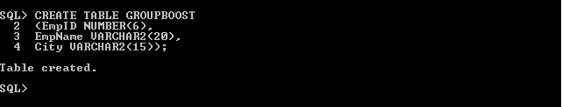

1. CREATE
It is used to create new table in the database.
2. DROP
Deletes both the structure and record stored in the table.

Slide 11
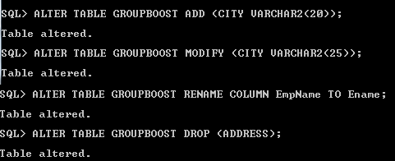
3. ALTER
Used to alter the structure of the database : ADD, MODIFY, RENAME, DROP.
4. TRUNCATE
Deletes all the rows from the table and free the space containing the table.

Slide 12
DML – Data Manipulation Language
INSERT
UPDATE
DELETE
DML commands are used to modify the database. It is responsible for all form of changes in the database.
The command of DML are not auto-committed. They can be rollback.

Slide 13
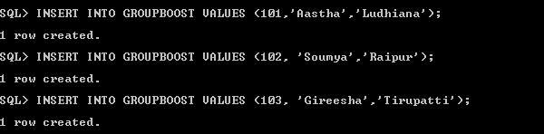

1. INSERT
It is used to create new table in the database.
2. DELETE
It is used to remove one or more row from a table.

Slide 14

3. UPDATE
This command is used to update or modify the value of column in the table.

Slide 15
DQL – Data Query Language
DQL is used to fetch the data from the database.
SELECT

Slide 16
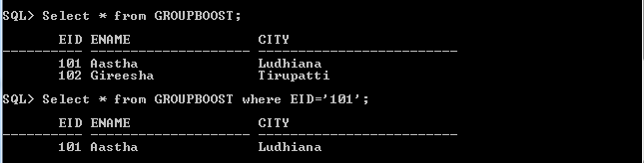
Select :
It is used to select the attribute based on the condition described by WHERE clause.

Slide 17
DCL – Data Control Language
DCL commands are used to grant and take back authority from any database user.
GRANT : Used to provide any user access privileges or other priviliges for the database.
REVOKE : Used to take back permissions from any user.
GRANT
REVOKE

Slide 18
Allow a User to create table
Grant all privilege to a User
Grant permission to create any table
Grant permission to drop any table
To take back Permissions

Slide 19
TCL – Transaction Control Language
TCL commands are used to manage transactions in the database. These are used to manage the changes made to the data in a table by DML statements.
It also allows statements to be grouped together into logical transactions.
COMMIT
ROLLBACK
SAVEPOINT

Slide 20
COMMIT - used to permanently save any transaction into the database.
ROLLBACK - restores the database to last commited state. It is also used with savepoint command to jump to a savepoint in an ongoing transaction.
SAVEPOINT - used to temporarily save a transaction so that you can rollback to that point whenever required.

Slide 21
SQL Joins
SQL Join is used to fetch data from two or more tables, which is joined to appear as single set of data. It is used for combining column from two or more tables by using values common to both tables.
TYPES :
Inner Join
Left Outer Join
Right Outer Join
Full Outer Join

Slide 22
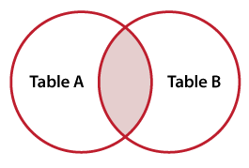
1. Inner JOIN
Select all records from Table A and Table B, where the join condition is met.
Select table1.column1,table1.column2,table2.column1,....
FROM table1
INNER JOIN table2
ON table1.matching_column = table2.matching_column;

Slide 23
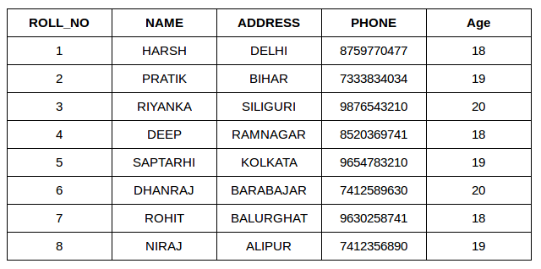
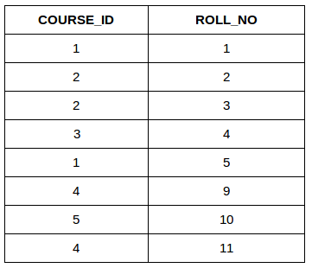
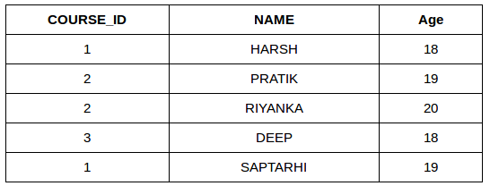
SELECT StudentCourse.COURSE_ID, Student.NAME, Student.AGE FROM Student
INNER JOIN StudentCourse
ON Student.ROLL_NO = StudentCourse.ROLL_NO;

Slide 24
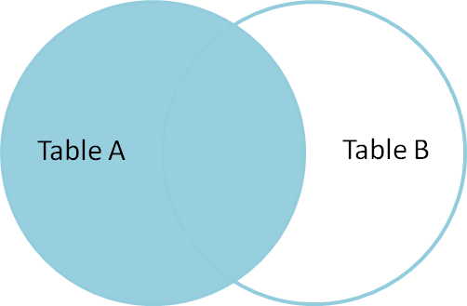
2. Left Outer JOIN
This join returns all the rows of the table on the left side of the join and matching rows for the table on the right side of join.
The rows for which there is no matching row on right side, the result-set will contain null.
Select table1.column1,table1.column2,table2.column1,....
FROM table1
LEFT JOIN table2
ON table1.matching_column = table2.matching_column;

Slide 25
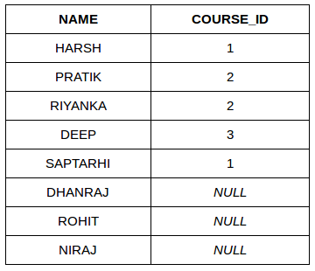
SELECT StudentCourse.COURSE_ID, Student.NAME, Student.AGE FROM Student
LEFT JOIN StudentCourse
ON Student.ROLL_NO = StudentCourse.ROLL_NO;

Slide 26
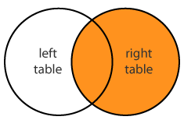
2. Right Outer JOIN
This join returns all the rows of the table on the right side of the join and matching rows for the table on the left side of join.
The rows for which there is no matching row on left side, the result-set will contain null.
Select table1.column1,table1.column2,table2.column1,....
FROM table1
RIGHT JOIN table2
ON table1.matching_column = table2.matching_column;

Slide 27
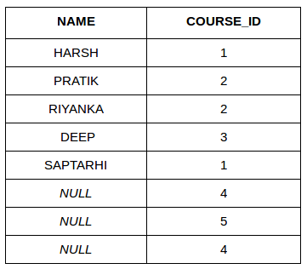
SELECT StudentCourse.COURSE_ID, Student.NAME, Student.AGE FROM Student
RIGHT JOIN StudentCourse
ON Student.ROLL_NO = StudentCourse.ROLL_NO;

Slide 28
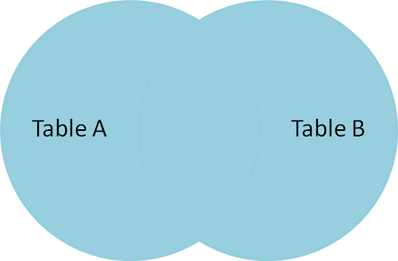
3. Full Outer JOIN
FULL JOIN creates the result-set by combining result of both LEFT JOIN and RIGHT JOIN
The result-set will contain all the rows from both the tables. The rows for which there is no matching, the result-set will contain NULL values.
Select table1.column1,table1.column2,table2.column1,....
FROM table1
FULL JOIN table2
ON table1.matching_column = table2.matching_column;

Slide 29
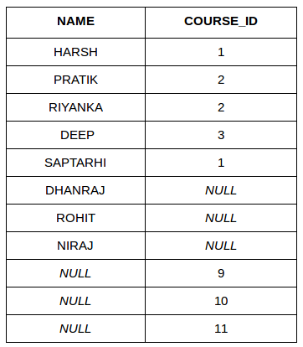
SELECT StudentCourse.COURSE_ID, Student.NAME, Student.AGE FROM Student
FULL JOIN StudentCourse
ON Student.ROLL_NO = StudentCourse.ROLL_NO;

